Slide 1



Loan Syndication

Slide 2


DISCLAIMER
The training content and delivery of this presentation is confidential, and cannot be recorded, or copied and distributed to any third party, without the written consent of Imarticus Learning Pvt. Ltd.

Slide 3

LEARNING OBJECTIVES
At the end of this session, you will be able to:
Understand about an Loan Syndication Concepts.
Participants involved in Loan Syndication
Types of Syndicated Loans
Syndicated Loan Life Cycle
Reconciliations Process

Slide 4
CORPORATE FINANCE LOANS
A loan that is extended to businesses by a financial institution.
Generally used to purchase long-term assets or help fund day-to-day operational costs.
Borrowers
Business
Lenders
Banks, NBFC, Credit Union
Security
Secured or unsecured
Term
Interest Rate
Repayment
Regular Installment
Fixed or Floating
Short term to Long term
Key Features of Commercial Loans

Slide 5
CORPORATE FINANCE LOANS
These loans are used for
Expansion / Acquisition
Working capital Management
Capital Purchases
Inventory Financing
Refinancing
Commercial loans are vital for business growth and operations. They provide businesses with access to funds that can be strategically used for expansion, managing cash flows, or investing in infrastructure and resources.

Slide 6

CORPORATE FINANCE LOANS CONTD.
Bilateral Loans
Syndicated Loans
An agreement with only one lender under a direct agreement
large loans provided to a single borrower by a group of lenders who work together to share the risk and funding

Slide 7
FINANCING SOLUTIONS
To maximize access to capital and suit individual business needs, banks provide either a standardized financing solution or tailor them for specific customer needs.
A group of banks (called a syndicate) provides the loan together. This spreads the risk.
One bank acts as the “lead agent” and handles the paperwork, coordination, and communication with the borrower.
The loan is secured using company assets like inventory, property, or unpaid invoices (accounts receivable).
It can be offered as a lump sum loan (cash-funded) or as a line of credit that the company can draw from as needed.
Useful for businesses that need a large amount of working capital—especially during tight cash flow or growth periods.
Since assets back the loan and risk is shared among lenders, it’s safer for the banks involved..
Syndicated
Asset-based Financing

Slide 8
Bilateral Loan vs. Syndicated Loan
Feature | Bilateral Loan | Syndicated Asset-Based Lending
Definition | A loan between one lender and one borrower | Loan backed by assets, funded by multiple lenders
Parties Involved | One lender, one borrower | Multiple lenders (syndicate) + borrower
Collateral | May be secured or unsecured | Secured by assets like receivables, inventory, property
Structure Complexity | Simple | Moderate to complex (requires syndication and collateral mgmt)
Credit Evaluation | Based on borrower’s credit profile | Based on quality of assets and borrower’s financials
Loan Amount | Typically smaller or mid-sized | Large financing needs
Repayment | Fixed schedule (term or revolving) | Flexible drawdowns based on asset availability
Debt on Balance Sheet | Yes | Yes
Use Case | General business needs, capex, working capital | Working capital, liquidity support for large firms
Typical Users | All business sizes | Mid to large corporates

Slide 9
Loan Syndication
The corporate loan syndication process is a structured method where a group of lenders, known as a syndicate, provides a single, large loan to one borrower, typically a corporation or government entity. This approach distributes risk among multiple institutions, making it feasible to fund substantial projects such as mergers, acquisitions, or infrastructure development that would be too large for any single lender.
Loan syndication is more than just pooling lenders together — it’s a carefully structured process where every participant is compensated for the risk, effort, and administration they take on.
From the initial mandate fee to the final exit charges, each stage introduces specific costs that shape the overall economics of the deal. For borrowers, recognizing these fees is critical to evaluating the real cost of capital. For lenders, it ensures transparency and fair value across the lifecycle of the loan

Slide 10
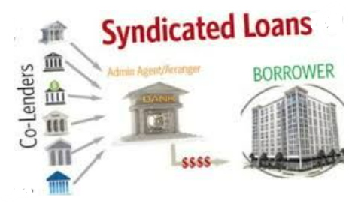

Slide 11
Loan Syndication Process Flow:
Origination/Pre-Mandate Stage: The borrower identifies a need for a large loan and approaches a single bank or financial institution to act as the lead arranger (also called the mandated lead arranger or syndicate leader). The lead arranger assesses the borrower's needs, project feasibility, and financial health, then designs the initial loan structure and terms in a proposal or "term sheet".
Preparation and Syndication: The lead arranger prepares a comprehensive information memorandum (IM) that details the borrower's financials, project specifics, and loan requirements for potential lenders. The arranger then approaches other banks and financial institutions to invite them to participate in the syndicate.
Negotiation and Documentation: Interested lenders conduct their own due diligence and negotiate the final terms and conditions, including interest rates, fees, repayment schedules, and covenants. Once an agreement is reached by all parties, a single, unified loan agreement is drafted by legal counsel and signed by the borrower and all participating lenders.

Slide 12
Loan Syndication Process Flow:
Closing and Disbursement: After all documentation is finalized and regulatory approvals are obtained, the syndicated loan is closed. Funds are then collectively disbursed to the borrower, either in a lump sum or in tranches (instalments) as needed for the project.
Administration and Monitoring: Throughout the life of the loan, an agent bank (often the lead arranger) manages the loan's administration, serving as the intermediary between the borrower and all lenders. This includes coordinating loan disbursements, collecting principal and interest payments from the borrower, distributing funds proportionally to participants, and ensuring compliance with the loan's terms and covenants.
The lead bank typically earns arrangement and underwriting fees for its work, while participating lenders receive a portion of the interest and other fees based on their contribution to the loan amount.

Slide 13
Loan Syndication Costs/Fees
Loan syndication is more than just pooling lenders together — it’s a carefully structured process where every participant is compensated for the risk, effort, and administration they take on. From the initial mandate fee to the final exit charges, each stage introduces specific costs that shape the overall economics of the deal. For borrowers, recognizing these fees is critical to evaluating the real cost of capital. For lenders, it ensures transparency and fair value across the lifecycle of the loan.
The loan syndication process involves multiple fees across its lifecycle — from mandate and arrangement fees at the start, to underwriting, agent, facility, and participation fees during execution, and finally exit or prepayment fees at closure paid by the Borrower.
Detailed Breakdown
1. Mandate/Arrangement Fee: Paid to the lead arranger for structuring and organizing the syndicate.
2.Underwriting Fee: Compensation for banks guaranteeing the loan before syndication is complete.

Slide 14
Loan Syndication Process Flow:
3. Upfront Fee: Paid to participating lenders for committing funds. Usually based on loan size and risk.
4. Agent Fee: Paid to the agent bank managing loan administration, interest payments, and communication.
5. Facility / Commitment Fees: Charged for keeping the loan facility available, even if not fully drawn / Paid on undrawn portions of the loan to compensate lenders for reserving capital.
6. Participation Fee: Incentive for lenders to join the syndicate, often negotiated.
7. Exit/Prepayment Fee: Charged if the borrower repays early or exits the facility before maturity.
8. Amendment/Waiver Fees: Paid when loan terms are renegotiated or covenants waived.

Slide 15
Loan Syndication : Primary & Secondary Market
Primary Market :The primary market is where syndicated loans are originated and structured. The borrower works with the lead bank (or multiple arrangers) to define the loan terms, pricing, and structure. Once the terms are finalized, the loan is underwritten and then sold to other lenders, such as commercial banks, institutional investors, hedge funds, and pension funds.
Secondary Market: Once the loan is funded, it can be traded in the secondary market, where existing lenders can sell portions of their commitments to new investors. The secondary market provides liquidity, allowing lenders to manage their risk exposure.
Loan sales in the secondary market can take two forms:
1. PAR Trades – When the loan is performing well and sold at or near face value.
2. Distressed Trades – When the borrower is experiencing financial difficulties, and the loan is sold at a discount due to increased credit risk.
Organizations such as the Loan Syndications and Trading Association (LSTA) in the U.S. and the Loan Market Association (LMA) in Europe help standardize practices and documentation for the secondary loan

Slide 16
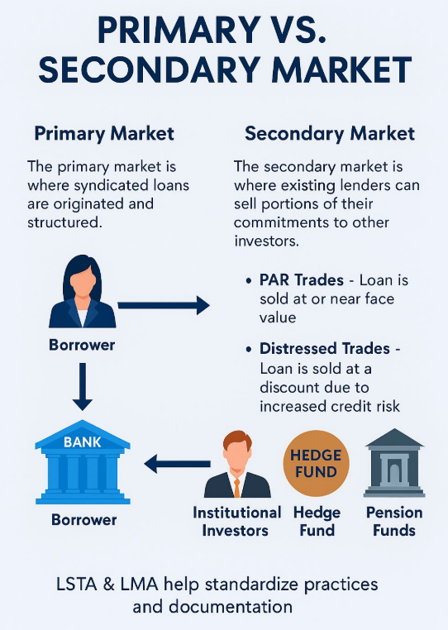

Slide 17
Syndicated Loan Structures
Syndicated loans can vary significantly in structure. They can be broad and widely syndicated, where a large number of institutional lenders participate, or more bilateral, with a small, select group of lenders providing financing in a more private arrangement. Common types of syndicated loan structures include:
1. Term Loans (TLA & TLB) – Fixed maturity loans where the borrower receives the full loan amount upfront and repays principal over time. TLBs (Term Loan B) are often structured for institutional investors with fewer amortization requirements and a large bullet repayment at maturity.
2. Revolving Credit Facilities (Revolvers) – A flexible loan where the borrower can draw, repay, and redraw funds as needed up to a set limit.

Slide 18
Syndicated Loan Structures
3. Delayed Draw Term Loans (DDTLs) – A term loan that allows the borrower to draw funds over a predetermined period rather than receiving the full amount upfront.
4. Bridge Loans – Short-term loans designed to provide temporary funding until permanent financing is secured.
5. Asset-Backed Loans (ABL) – Loans secured by the borrower’s assets, often used in structured finance.
6. Mezzanine Loans – High-risk, high-yield loans that sit between senior debt and equity financing, often used in leveraged buyouts.

Slide 19


Life Cycle of a Loan

Slide 20
INTRODUCTION TO LOAN PROCESS
Understanding how commercial loans are processed helps businesses prepare better and improve their chances of approval.
Commercial loans support business needs such as expansion, working capital, equipment purchase, or project financing.
A well-organized loan process ensures both the lender’s risk is managed, and the borrower receives the most suitable financial solution
Syndicated
Loan
Debt - based funding arrangement offered by banks or financial institutions to businesses rather than individuals.
Objectives
Assess business credit worthiness
Evaluate risk and repayment capacity
Ensure appropriate structure and documentation
Comply with internal and regulatory requirements
Typical Borrowers:
Large corporations
Public sector entities
Large NBFCs
Loan Types
Term loan
Lines of credit
Asset-based lending

Slide 21
LIFE CYCLE OF A SYNDICATE LOAN
Origination to contract management.
Loan Processes
Loan Processes
Origination
Processing
Underwriting
Closing and
Post Closing
Servicing
Funding
Technology
Purchase
Product
Purchase
Product
Delivery
Delivery
Borrower
Borrower
Risk
Risk
Loan File Setup
Clearing
Loan File Setup
Development
Clearing
Development
Risk
Risk
Management
Verification
Management
Verification
Assessment
Assessment
Processing &
Post Closing
Processing &
Product
Post Closing
Product
Automated
Document follow-up
Automated
Validate
Validate
Reporting
Placement
document
Reporting
Placement
Validate
Underwriting
Validate
Underwriting
Funding
Funding
follow
Domain Specific
-
up
Domain Specific
Conditions
Conditions
Escrow
Lead
Escrow
Lead
Operations
Operations
Appraisal Order
Appraisal Order
Document
Document
Management
Validation &
Management
Generation
Validation &
Generation
Capability
Capability
Loan Approval
Loan Approval
Validation
Validation
Delivery
Conditions
Delivery
Conditions
Collections,
Loan Setup
Collections,
Loan Setup
Asset Grading
Clearing
Asset Grading
Clearing
Warehousing
Warehousing
Foreclosures
Secondary
Foreclosures
Secondary
Quotes & locks
Quotes & locks
Marketing
Marketing
Other
Operations
Customer Relationship Management, Finance and Accounting, Human Resources and Help Desk

Slide 22
LIFECYCLE OF A SYNDICATE LOAN - CREDIT ANALYSIS
Credit Analysis Process
Credit analysis assesses a borrower's loan application to see if they can generate enough cash flow to meet their debt obligations.
This process includes gathering information from the borrower, evaluating it, and deciding whether to approve the loan.
Techniques like ratio analysis, trend analysis, cash flow analysis, and projections are used to evaluate the borrower's creditworthiness.

Slide 23
LIFECYCLE OF A SYNDICATED LOAN CREDIT ANALYSIS
Actor | Key Activity | Purpose
Lead Bank | Negotiates and agrees on broad terms of sanction with the customer | Aligns on preliminary loan terms before further evaluation
 | Coordinates and conducts site inspection | Physically verifies project and its viability
 | Performs subjective and objective analysis | Combines field insights with financial analysis
 | Validates the complete credit analysis | Internal review to ensure accuracy and policy compliance
 | Makes credit decision and communicates it to the customer | Final approval/rejection of the loan request

Slide 24
LIFECYCLE OF A LOAN- COLLATERAL
Definition and Role
Collateral is a borrower's pledged asset (such as real estate, equipment, inventory, or receivables) that secures the loan and protects the lender in case of default.
Risk Mitigation Tool.
It reduces the credit risk for the bank by offering a form of security that can be liquidated to recover dues if the borrower fails to repay
Assessed During Credit Analysis
Collateral is carefully evaluated for its value, ownership, legal standing, and ease of liquidation during the credit appraisal stage.
Forms of Collateral
Common forms include fixed assets (land/buildings), current assets (inventory, receivables), financial assets (deposits, securities), and third-party guarantees.
Lifecycle Presence
Collateral plays a role across multiple loan stages—origination (assessment), documentation (legal creation of charge), monitoring (regular valuation), and closure (release or enforcement).
Legal Perfection & Lien Creation
A proper legal charge is created on the collateral—such as a mortgage, hypothecation, or pledge—to ensure enforceability in case of default.
Ongoing Monitoring
The value and condition of collateral are monitored throughout the loan tenure to ensure continued adequacy of security cover.

Slide 25
LIFECYCLE OF A COMMERCIAL LOAN - COLLATERAL
Collateral
Securities
Any property or asset
Given by a borrower to a lender to secure a loan
Collateral can be the title of a parcel of land, a car, or a house
Collateral, and /or the ownership title to it, stays with the lender throughout the time the borrower is paying the loan
Refer specifically to financial assets (such as stock shares) that are used as collateral
Securities are assets such as bonds and stocks
Securities portfolio remains under the borrower’s control

Slide 26
LIFECYCLE OF A COMMERCIAL LOAN - UNDERWRITING
The lender evaluates whether a borrower's loan application poses an acceptable risk.
Underwriters analyze the borrower’s credit v/s collateral to determine their ability to repay the loan.
Credit indicates a borrower's management of debt and their historical performance, derived from credit reports from agencies like Equifax, TransUnion, and Experian.
Capacity indicates a borrower's capability to repay a loan, taking into account their income, existing debts, and assets as evaluated by the underwriter.
Collateral is an asset or property that an individual or entity offers to a lender as security for a loan.

Slide 27
LIFECYCLE OF A LOAN - UNDERWRITING
Stage | Description
Application Review | Assess the completeness of the loan application and initial eligibility checks.
Document Collection | Gather financial statements, tax returns, legal documents, project details.
Financial Analysis | Evaluate borrower’s income, cash flows, balance sheet, and financial ratios.
Collateral Evaluation | Assess the value, ownership, and lien status of proposed collateral.
Risk Assessment | Analyze industry risk, borrower history, credit score, and market conditions.
Credit Scoring & Rating | Assign a risk rating or credit score to the borrower.
Terms Structuring | Decide on loan amount, interest rate, tenure, repayment schedule, and covenants.
Credit Approval | Present findings to the credit committee or approver for final sanction.
Communication of Decision | Inform the borrower of the approval, rejection, or need for modifications.
Loan Servicing

Slide 28
LIFECYCLE OF A COMMERCIAL LOAN - LOAN SERVICING
Loan servicing involves managing a loan from the time the funds are disbursed until it is fully repaid.
Loan servicing begins shortly after the loan approval process is completed.
Approval signifies the covenants and disbursal timeline for the loan.
Once the loan is closed and booked, information from the Loan Origination system is transferred to the Lending Bank’s Loan Servicing system to oversee servicing activities throughout the loan's duration.

Slide 29
LIFECYCLE OF A COMMERCIAL LOAN - LOAN SERVICING
Step | Description
Utilisation/Drawdown Management / Disbursement | Release of approved loan amount based on utilisation requests and disbursement schedule.
Billing/Invoicing | Generation of periodic invoices for interest, fees, and charges as per loan agreement.
Payments Management | Recording and monitoring of payments made by the borrower towards loan obligations.
Contract Management | Administration and upkeep of loan contracts, terms, renewals, and amendments.
Collateral Management & Insurance | Regular monitoring and valuation of pledged collateral and ensuring valid insurance coverage.
Delinquency Management | Tracking overdue payments, sending reminders, and initiating recovery actions if necessary.
Document Management | Maintaining all related documents such as agreements, guarantees, communication, etc.
Controls | Internal checks and compliance reviews to ensure loan servicing is within policy.
Servicing Events | Handling of life-cycle events like rate changes, restructures, top-ups, etc.
Contract End Management | Managing closure of loan contracts—repayment, settlement, release of security, etc.
Customer Interaction | Ongoing support and communication with the borrower for servicing-related matters.

Slide 30
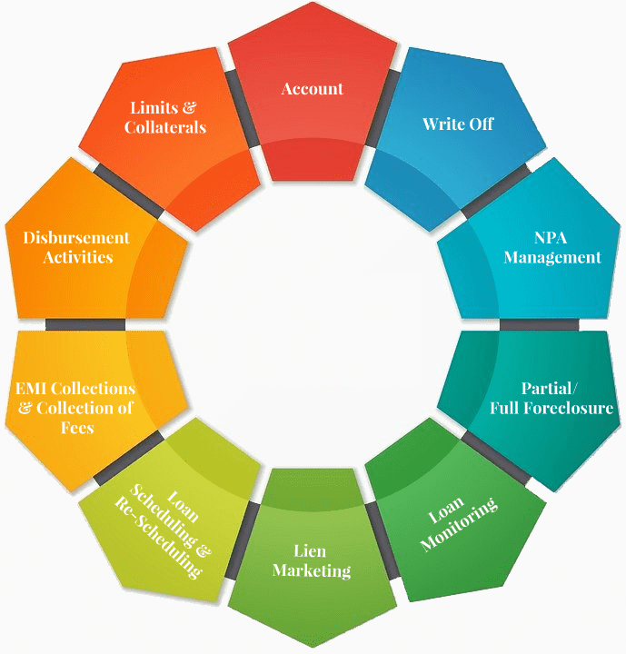
LIFECYCLE OF A CORPORATE LOAN - LOAN DISBURSEMENT
A Corporate loan drawdown refers to the process by which a borrower accesses funds from an approved loan facility. Instead of receiving the full loan amount upfront, funds are "drawn down" as needed, typically in tranches.
Aligns disbursements with project or business cash flow needs
Reduces interest costs by borrowing only when necessary
Allows better financial control and planning
Key Applications: Real estate and construction financing Working capital loans ; Equipment or infrastructure purchases
Loan Drawdown

Slide 31
LIFECYCLE OF A CORPORATE LOAN - LOAN DISBURSEMENT
Feature | Annuity Loan | Amortized Loan | Bullet Loan
Repayment Structure | Fixed periodic payments (equal installments) | Gradually reducing principal + interest | Interest-only until maturity, principal repaid in lump sum
Installment Amount | Same throughout the loan term | Varies (interest reduces over time, principal increases) | Small periodic interest payments; large final payment
Principal Repayment | Included in each payment | Gradually repaid over the loan term | Entire principal repaid at maturity
Interest Calculation | Based on reducing principal balance | Based on outstanding principal | Based on full principal throughout loan term
Cash Flow Impact | Predictable; stable outflows | Higher initial payments, lower over time | Low cash outflows during the term, high at maturity
Common Use Cases | Mortgages, car loans, consumer finance | Equipment loans, term loans with flexibility | Bonds, bridge loans, mezzanine finance
Risk Profile for Lender | Lower, due to steady repayment of principal | Moderate; depends on borrower's payment capacity | Higher; principal risk remains till maturity
Suitability for Borrower | Stable cash flow scenarios | Projects with phased revenue generation | Borrowers expecting lump sum inflow or refinancing later

Slide 32
LIFECYCLE OF A CORPORATE LOAN - LOAN DISBURSEMENT
Back-end activities include:
Setting up a loan account
Capturing loan disbursement details
Drawdown schedule, last available date
Currency, amount, tenor, repayment schedule
Capture details of collateral, etc.

Slide 33


LOAN SERVICING EVENTS
Billing Cycle
Interest receivable schedule
Principle repayment schedule
Penal/ overdue interest / principle receivable
Charges, fees, rebates, refunds management
Billing / invoicing
Reminders
Billing and Invoicing
Payment instructions management – direct debits, manual payments
Receive cheque payment or fund transfers
Appropriate principle, interest, charges, other receivables
Payments Management

Slide 34


LOAN SERVICING EVENTS
Process payment received
Pre payment, underpayment, overdue payments
Review /monitor contract
Manage interest conditions – Floating rates, mark up, mark down
Limit adjustments
Customer reports
Credit reports
Contract Management
List of collateral under the contract
Substitution, release of collaterals
Collateral valuation, mark to market
Monitor collateral
Liens
Collateral Management

Slide 35

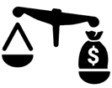
LOAN SERVICING EVENTS
Principle /Interest waivers
Premature payments
Reduce / waive fees
Restructure loans – duration, interest rates, instalments
One time settlements
Legal actions
Write offs
Delinquency Management
Accounting entries for individual loan events
Reconciliations
Risk, regulatory and tax controls
Fraud and anti money laundering monitoring and control
Business activity monitoring
Exceptions handling
Controls

Slide 36


LOAN SERVICING EVENTS
Statements
Status reporting
MIS
Analytical reporting
Customer Servicing
Process contract end checks
Refunds, recoveries, fees , charges
Release charges on collaterals / securities (lien release)
Notify insurance
Release documents
End contract processing
Contract End Management

Slide 37
SUMMARY
Step No. | Loan Servicing Event | Description | Tools / Processes Involved | Key Risks / Challenges
1 | Contract & Collateral Management | Recording loan terms, covenants, and collateral details | Loan origination system, document repository, legal compliance checks | Incomplete data, legal enforceability, collateral misvaluation
2 | Billing & Invoicing | Generation and dispatch of periodic payment schedules and interest notices | Loan servicing software, payment schedules, auto-invoicing | Errors in billing, incorrect interest calculation
3 | Payment Management | Receiving, allocating, and reconciling payments from borrowers | Payment gateway, accounting systems, reconciliation engines | Misapplied payments, system failures, late receipts
4 | Customer Servicing | Ongoing communication, account queries, statement requests | CRM, call center, email, chat support | Poor response time, misinformation, reputational risk
5 | Delinquency Management | Identifying and managing late or missed payments | Aging reports, dunning systems, collection workflows | Rising NPAs, legal recovery delays, compliance with fair practices
6 | Controls & Compliance | Monitoring internal controls, audit trails, and regulatory compliance | Internal audit, SOX tools, regulatory reporting modules | Regulatory breaches, audit gaps, lack of segregation of duties
7 | Contract End Management | Closure, renewal, settlement, or refinancing of the loan | Closure letters, lien release, renewal agreements | Improper closure, missed documentation, lien release delays

Slide 38
Loan Syndication - Reconciliations Operations
Reconciliation is crucial & critical process of making sure that everyone’s accounting records match perfectly
In a syndicated loan, we have:
The Borrower: The company taking the loan.
The Lead Bank (Agent): The "Group Leader" who collects money from the borrower and distributes it to others.
Participant Banks: The other banks who contributed money.
Reconciliation is the "Check-and-Verify" step. It ensures that the amount the Borrower says they paid matches what the Agent Bank says they received, and what the Participant Banks say they were given.
How it Works (The Flow)
Payment: The Borrower pays the total interest/principal to the Agent Bank.
Distribution: The Agent Bank calculates each bank's share (e.g., Bank A gets 30%, Bank B gets 70%) and sends the money.
The Comparison: At the end of the month, all parties compare their records.
Internal Record: "I should have received 30 m$."
Bank Statement: "I actually received 25 m$"; hence there is a break of 5 m$
Result: If they match, the account is "reconciled." If not, it's a "Break."

Slide 39
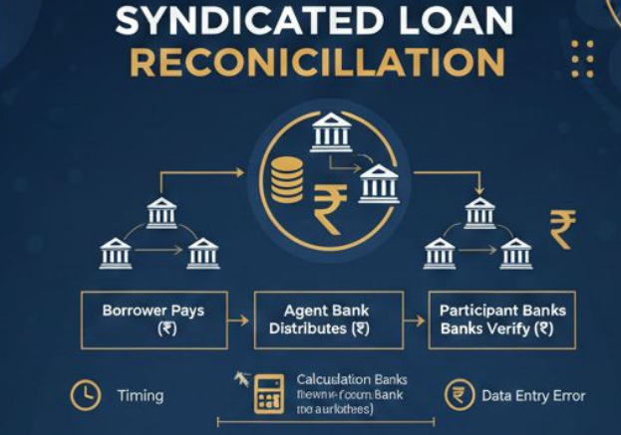
Reconciliation
Reconciliation is the process of making sure that everyone’s "notebooks" (accounting records) match perfectly.
Trust: Participant banks need to know the Lead Bank is distributing money fairly and on time.
Regulatory Compliance: The Regulators and auditors require banks to prove their books are 100% accurate.
Risk Management: If a payment is missed and not caught through reconciliation, it could look like the borrower is defaulting (failing to pay) when they actually aren't.
Possible Reconciliation "Breaks" (Errors) : A "Break" is simply a mismatch between two sets of records.

Slide 40
TYPES OF RECON - BREAKS
Reconciliation is the process of making sure that everyone’s "notebooks" (accounting records) match perfectly.
Types of Recon Breaks : Common causes include:
Timing Difference : The borrower paid on Friday, but the bank recorded it on Monday.
Calculation Error : The Agent Bank calculated 10% interest instead of 10.5%.
Tax Issues (TDS) : The borrower deducted Tax Deducted at Source (TDS) but didn't inform the bank, so the cash received is less than expected.
Currency Fluctuations : If the loan is in Dollars ($) but the bank records in Rupees (₹), the exchange rate might change between the time of payment and recording.
Data Entry Error : Someone typed $10,00,000 instead of $1,00,000 (a "fat-finger" error).

Slide 41
RECON BREAKS - FIXING SOLUTIONS
Reconciliation is the process of making sure that everyone’s "notebooks" (accounting records) match perfectly.
Fixing these Breaks
Fixing a break is like being a financial detective. The steps are:
a) Identification: Use software to flag any entries where Record A ≠ Record B.
b) Investigation: Look at the "Transaction Memo" or "Swift Message" (bank receipt) to see where the numbers diverged.
c) Communication: The Agent Bank contacts the Participant Bank or Borrower to clarify (e.g., "Did yo deduct TDS?").
d) Correction: If it was a manual error, pass a "Rectification Entry" (like you learn in Accountancy).
If it was a timing issue, just mark it as "Cleared" once the money hits the statement.
Final Settlement: Adjust the cash balance so the books show the true picture.

Slide 42
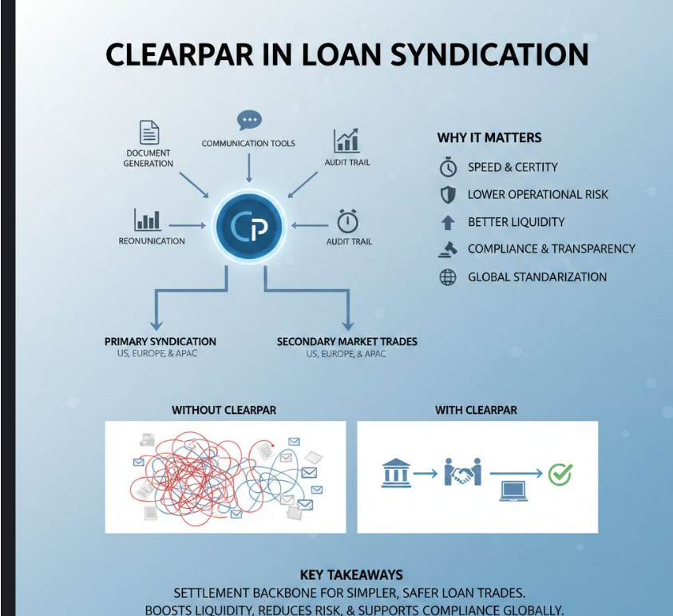
LOAN SYNDICATION - TOOL

Slide 43
CLEARPAR - APPLICATION TOOL
ClearPar is technology platform used by agents banks to process the Loan Syndication Operations
ClearPar is a technology platform used by banks, institutional investors, and agent banks to settle syndicated loan trades efficiently. It automates document generation, communication between counterparties, portfolio reconciliation, and maintains an audit trail, covering both primary syndication and secondary market trades across US, Europe, and APAC. In APAC, ClearPar is highlighted for streamlining historically manual settlement practices, improving efficiency, and supporting compliance with industry standards; Where ClearPar fits in the workflow
Document generation: Creates standardized contracts and confirmations needed for loan trades, aligned with LMA/LSTA standards.
Communication tools: Connects buyers, sellers, agent banks, custodians, and lawyers to resolve trade details faster.
Portfolio reconciliation: Helps parties match positions and settle differences, reducing operational breaks.
Audit trail: Stores time-stamped records of actions to manage risk and aid compliance and dispute resolution.
Primary and secondary workflows: Supports straight-through processes from initial syndication to later transfers, including par and distressed trades.

Slide 44
CLEARPAR - APPLICATION TOOL
ClearPar is technology platform used by agents banks to process the Loan Syndication Operations
Why ClearPar is important
Speed and certainty of settlement: Faster trade settlement means lenders can quickly update who holds what portion of the loan, reducing delays and funding costs.
Lower operational risk: Automation reduces manual errors in documents, calculations, and communications, which can otherwise cause costly settlement failures.
Better liquidity: When trades settle reliably, more investors are willing to participate, making it easier to buy/sell loan exposures and keep the market active.
Compliance and transparency: The audit trail and standardized workflows help meet industry and regulatory expectations, which is crucial for banks and institutional investors.
Global standardization: ClearPar reflects common market standards (LMA/LSTA) and is used across regions, helping Indian market participants integrate with global practices.

Slide 45
CLEARPAR - APPLICATION TOOL
ClearPar is technology platform used by agents banks to process the Loan Syndication Operations
Simple example
Scenario: A 1,000 m $ syndicated loan has 10 lenders. One lender wants to sell 100 m$ of its share to another investor. Without ClearPar: Multiple emails, manual drafts, version mismatches, and delays increase settlement time and risk. With ClearPar: Standard docs are auto-generated, parties communicate in one platform, positions are reconciled, and an audit trail tracks every step—leading to quicker, cleaner settlement. Key takeaways ClearPar is the settlement backbone for syndicated loan trades, making complex, multi-party processes simpler and safer. It boosts liquidity, reduces risk, and supports compliance across primary and secondary loan markets.

Slide 46



THANK YOU !!!
Contact us today! https://imarticus.org/

